Slide 1
Hierarchical Clustering
USUPERVISED LEARNING

Slide 2
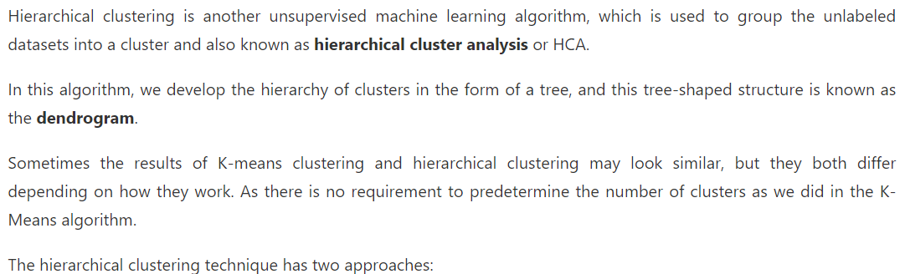
Introduction

Slide 3
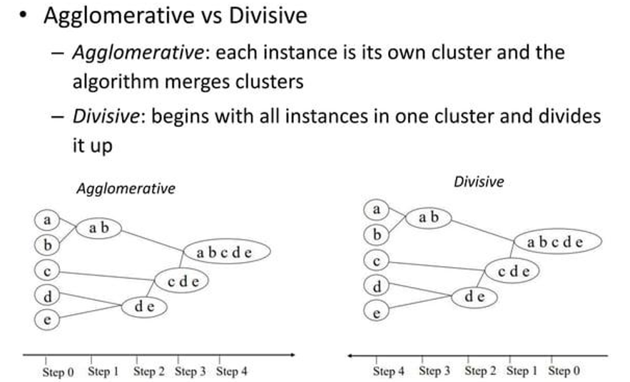
Types

Slide 4
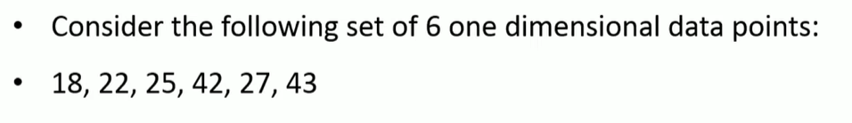
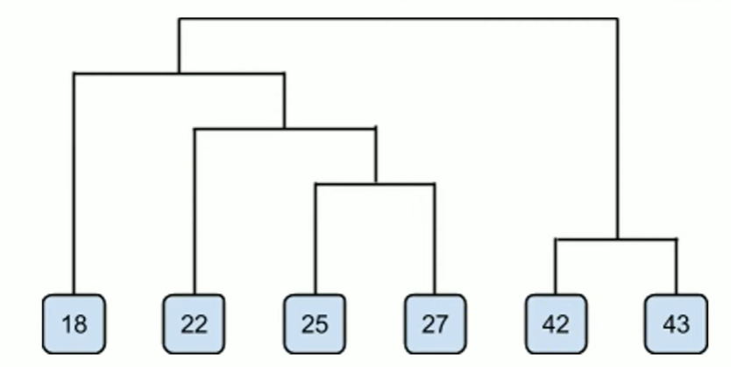
Example of Agglomerative

Slide 5
Types of linkage
Single
Average
Complete

Slide 6
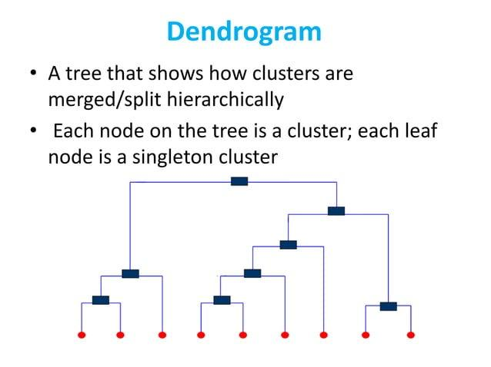

Slide 7
